Slide 1


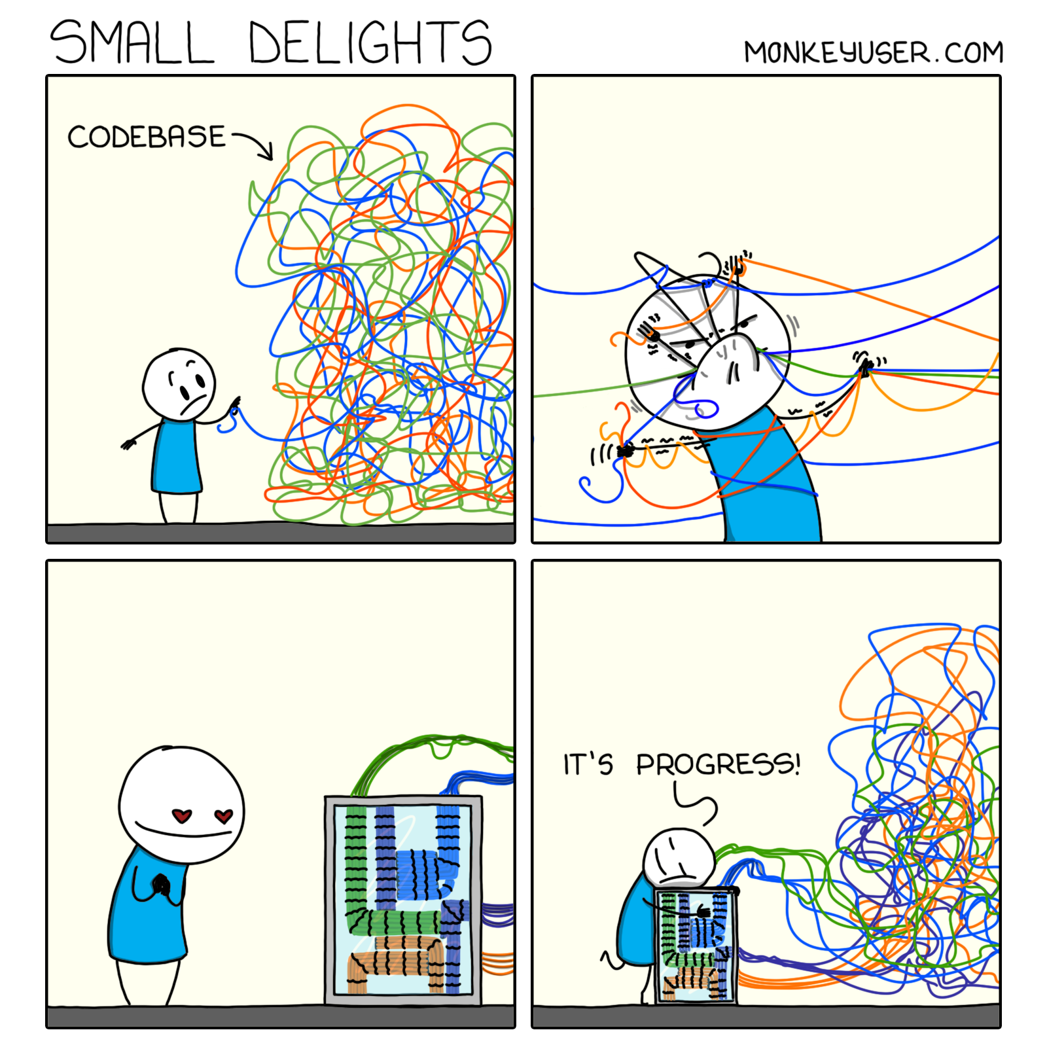
Make mistakes
Sumon Nath
Notes:
Indian flag

Slide 2
General/Coding

Slide 3

Where to start?

Slide 4
Where to start?
Best way to learn is to implement a feature
Implement or develop a considerably big feature
Not an extra stat like the average MSHR occupancy
Notes:
That can be a new feature or a implementing a paper that has already not implemented.
Not like just modifying code here and there.

Slide 5

Attention span problem

Slide 6
Attention span problem
Code snippet you don’t understand
Try to get a rough understanding
Implement your feature
Add new feature

Slide 7
Attention span problem
Get a good understanding of a particular feature/entire module
Document it
Champsim
ooo_cpu.cc is important for all
Cache : cache.cc
Gives Mental map of codebase
Inspiration for you feature
TLB : ptw.cc
DRAM : dram_controller.cc
Notes:
Need to beautify

Slide 8

Ignorance problem

Slide 9


Ignorance problem
Tomorrow’s problem
“Hard”/tricky code
Notes:
Same thing happened to me with Berti, a lot of pointer manipulation and pointer arithmetic, ignored it multiple times, and the end I had to go through entire code.

Slide 10
Ignorance problem
Take your time
Understand the code thoroughly, even if it takes hours/days
Notes:
Even true for cases where you can write a nice modular code, but you write some shitty spaghetti code, which will be hard to debug later

Slide 11

Lost code problem
Feat: Integration of level 0 DTLB with TLB hierarchy
Feat: Timegaurd policy for level 0 DTLB
A
B
Notes:
Give names to feature A and feature B.

Slide 12
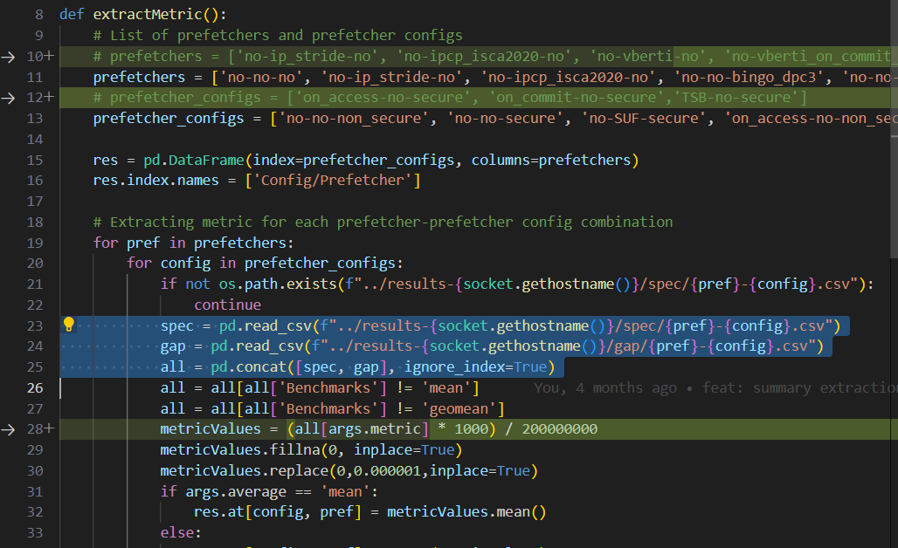
Lost code problem

Slide 13

Lost code
Vim diff with baseline. ☹
Use git for version control. ☺
Commit feature A & feature B.
History of all your changes.
Make branches for every feature you work on.
Why? This is important in collaborations.
Notes:
Give names to feature A and feature B.

Slide 14


Lost code/data
Code Data
Notes:
Give example of the time your data was lost due to a power cut

Slide 15
Lost code/data
Set up backup script
Backup to other servers or best to your machine
Use scp /rsync command
Use crontab to schedule it hourly
Notes:
Give names to feature A and feature B.

Slide 16



Speedup coding
Start using Vim/Emacs
Why?
Way faster editing
More cooler than other IDEs
Neovim more complete soln.
Notes:
Keyboard only, way faster at jumping around files
You must have seen Khushank with 4 tabs open and navigating so fast

Slide 17
Debugging

Slide 18
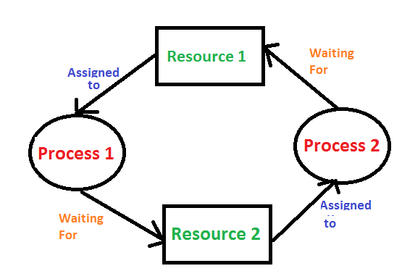

Deadlocks (Champsim)
CPU
L1D
Request
L2
LLC
DRAM

Slide 19

Deadlocks (Champsim)
CPU
L1D
Request
L2
LLC
DRAM
Notes:
Very daunting at first. But very easy honestly.

Slide 20
Deadlocks
How to solve?
Notes:
Old champsim, some version of it has the facility but you can code it up as well. Discuss how they can do so.

Slide 21

Deadlocks
How to solve?
Generate logs
1 instr. with 50 lines of logging info : log file size 1KB
For 1M instruction ~ 1GB
Notes:
Old champsim, some version of it has the facility but you can code it up as well. Discuss how they can do so.

Slide 22
Deadlocks
How to solve?
Generate logs
1 instr. with 50 lines of logging info : log file size 1KB
For 1M instruction ~ 1GB
Setup a logging system for a specified instruction
Print debug statements for the deadlock instruction
Identify where the packer is lost
Notes:
Old champsim, some version of it has the facility but you can code it up as well. Discuss how they can do so.

Slide 23
Segfaults
LeapFrogging

Slide 24
Segfaults
LeapFrogging

Slide 25
Segfaults
LeapFrogging

Slide 26
Segfaults
LeapFrogging

Slide 27
Segfaults
LeapFrogging

Slide 28

Segfaults
LeapFrogging

Slide 29

Segfaults
Print statements won’t work
Use the debugger(gdb)
Identify the state of all the variables/objects
My case -> read queue
Notes:
I could not identify for a very long time that this could happen. As the intended behavior of queues are queue and dequeue.

Slide 30
Infinite loops
See the control flow : backtrace
Identify the repeated calls
Notes:
Need to set breakpoints and see the which functions or entities are called

Slide 31
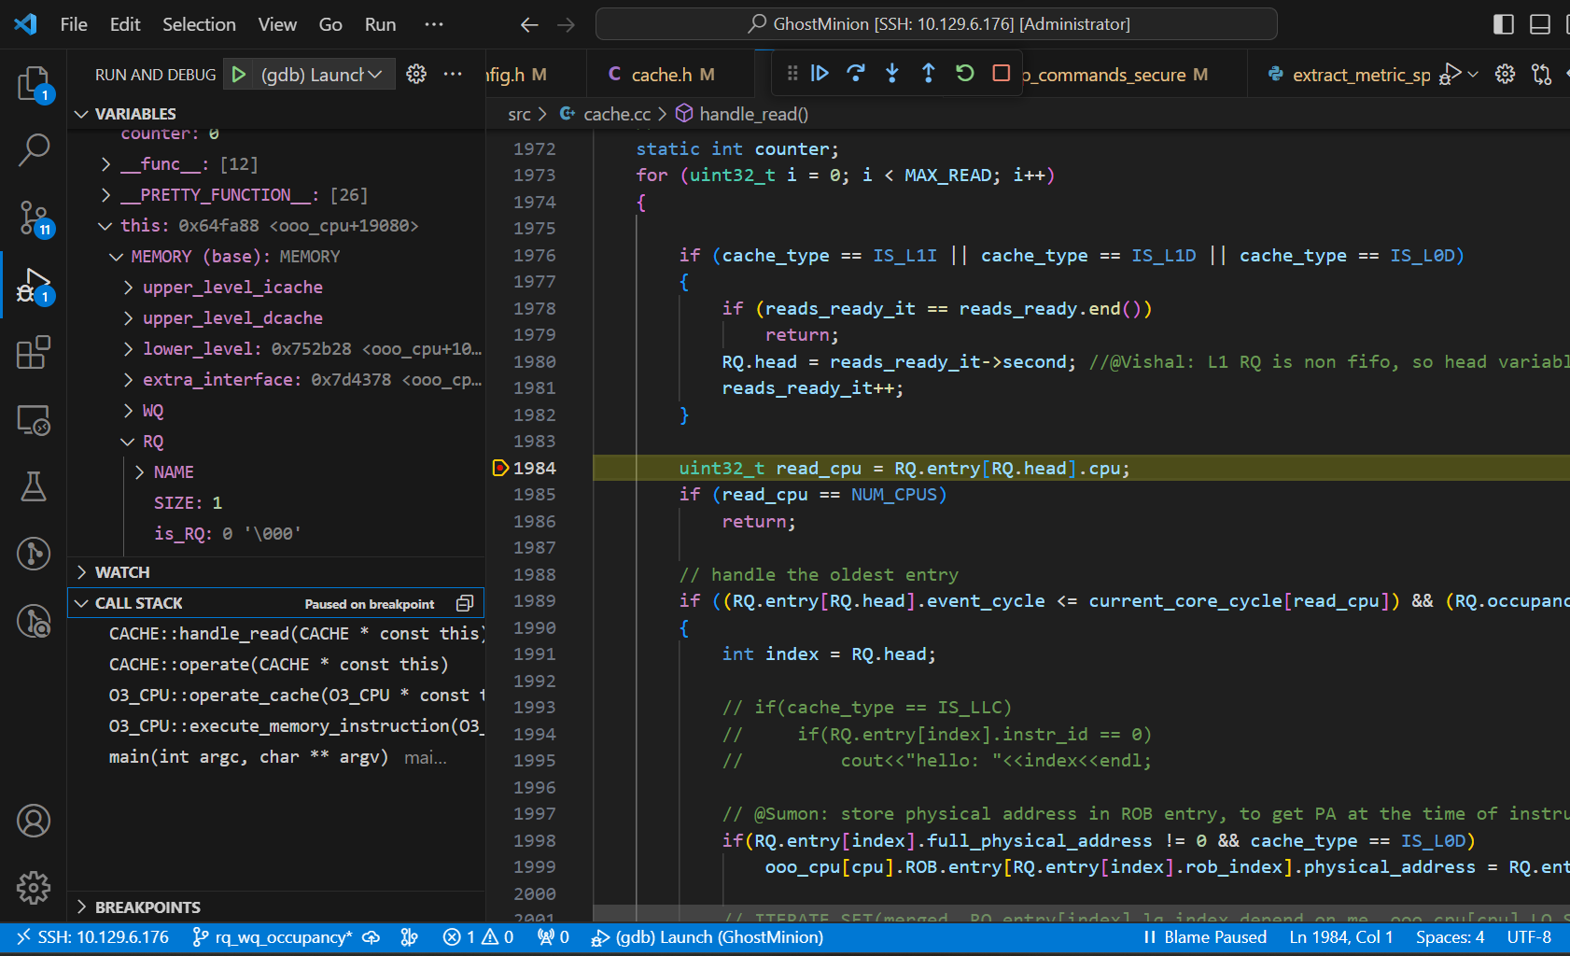
Vscode debug env
Video link
Vscode debug config
Notes:
I could not identify for a very long time that this could happen. As the intended behavior of queues are queue and dequeue.

Slide 32

Logical errors
Naman was facing a problem
Both useless and useful prefetches were 0

Slide 33
Logical errors
Naman was facing a problem
Both useless and useful prefetches were 0
Find where exactly these counters are incremented
Understand the code flow
Try to find out why the counters are not increasing
Trace back

Slide 34
Testing and Verification
What is a good setup for testing?
Run for small # of instructions
2M warmup & 5M sim

Slide 35

Testing and Verification
How to verify ?

Slide 36
Testing and Verification
How to verify ?
Assert statements -> sanity checks
Stats/output should agree with functionality
Code reviews*

Slide 37
Experiments

Slide 38
Experimentation
Testing -> verification -> a lot of experiments
Sensitivity analysis – vary 1 parameter, analyze system behavior
Lots of parameters
Run time
Compile time (Macros)
# of instructions
Replacement policies
L1D Prefetcher
Cache size
Knob
Notes:
Some experiments might be specific like, the one Ravi was doing average WQ occupancy across the simulation

Slide 39
Mistakes in experiments
Same experiments, with varying parameters
Run time params -> easy to change
Compile time params
Change code before every build
Example
3 macros
4 value per macro
number of combinations = 12
30 secs to edit the macros
every set of experiments 6 mins

Slide 40
Automate compile time params
Use sed command
Uncomment macros to Turn ON knobs
Comment macros to Turn OFF knobs
Build script

Slide 41
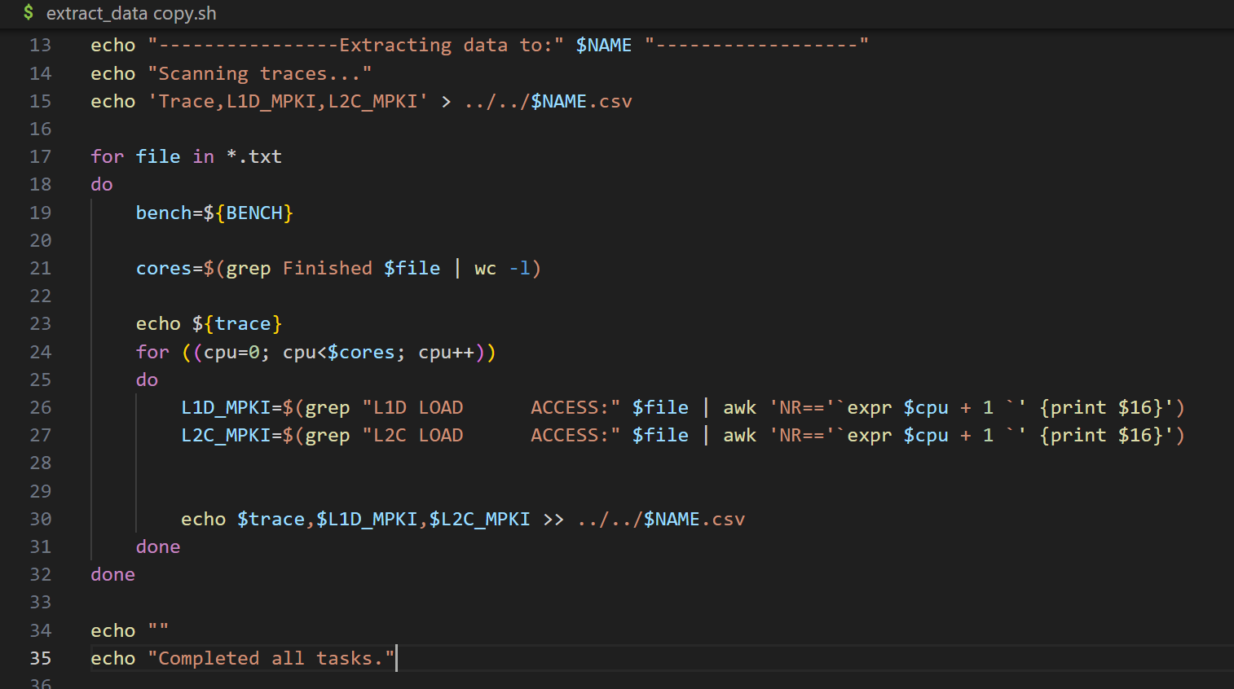
Problem with data extraction

Slide 42
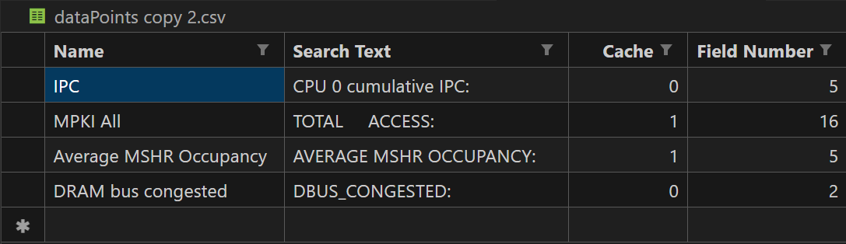
Automate data extraction
Create json/xml/csv with all the datapoints
Script adaptively extract the datapoints -> extraction script

Slide 43

More automation -> into the cloud
Upload all extracted data to google sheets
Use the sheets api reference
Upload script

Slide 44

Cherry on top
The master script
Build
Run
Extract data
Upload
Plotting
Email*

Slide 45

Beyond the terminal limits
Run experiments in background (& symbol)
Experiments halts if parent terminal closes/ssh session expired
Notes:
Terminal multiplexer
Maintain multiple terminal sessions at the same time

Slide 46
Beyond the terminal limits
Run experiments in background (& symbol)
Experiments halts if parent terminal closes/ssh session expired
Detach process from terminal : differnt ways
Use Tmux : most used commands
Notes:
Terminal multiplexer
Maintain multiple terminal sessions at the same time

Slide 47

Before the deadline
96 cores
96 cores
96 cores
6 experiments
90 benchmarks per experiment
Each experiment takes 1 hour
How long will it take?

Slide 48
Before the deadline
96 cores
96 cores
96 cores
6 experiments
90 benchmarks per experiment
Each experiment takes 1 hour
How long will it take?
Problem: merging data
Output

Slide 49
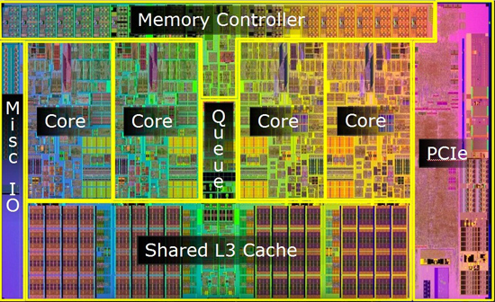
Multicore experiments
Usually take longer time, sometimes a day or more
Homogenous: 1 trace in all cores
Heterogenous: mix of traces
Notes:
Usually you perform these experiments at the later stages of your work. Unless you are working on some multicore topic.

Slide 50
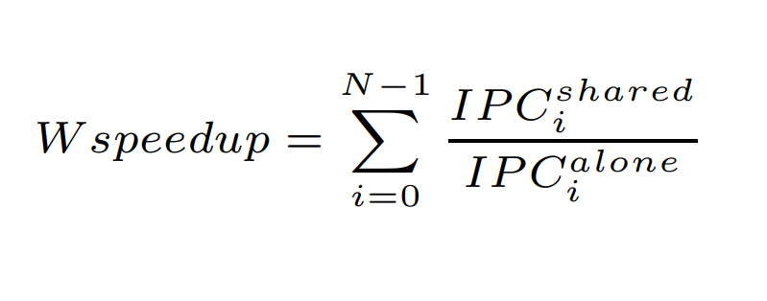
Multicore experiments
Speedup: weighted speed
Plot: S-cure
Notes:
Usually you perform these experiments at the later stages of your work. Unless you are working on some multicore topic.

Slide 51
Plots

Slide 52
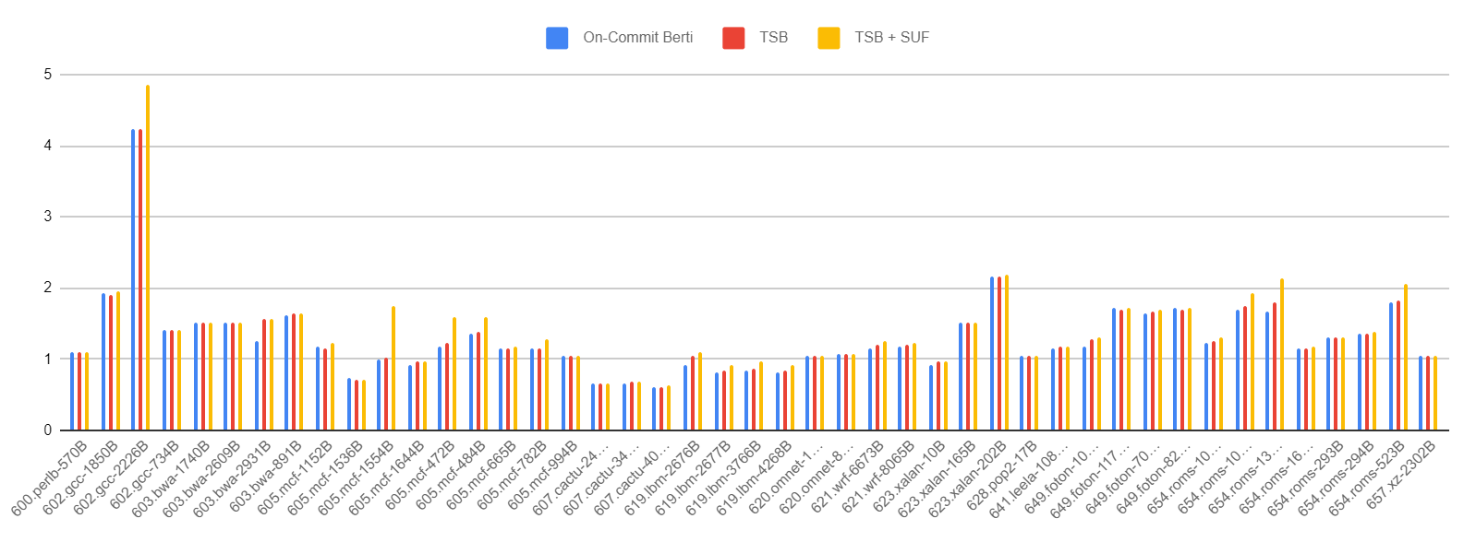
Good, Bad & Ugly
Normalized speedup

Slide 53
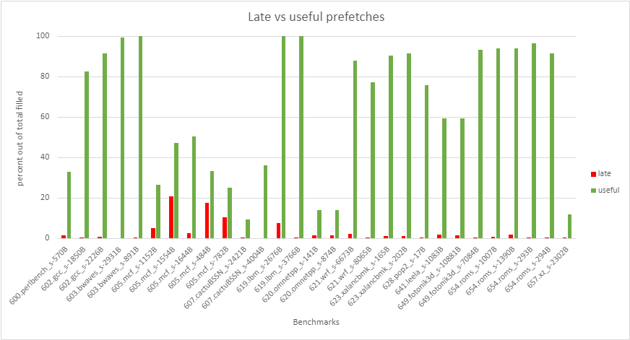
Good, Bad & Ugly

Slide 54
Good, Bad & Ugly
Baseline: Non-secure system with no prefetching

Slide 55
Plotting good practices
Use large fonts (should be same as text size)
Plot axes/ legends/ colors should be coherent
Should not be blurred or stretched
Axes titles: first letter of first word caps
Mention baseline if applicable

Slide 56
How to write a report?
Go through this link:
https://www.cse.iitb.ac.in/~biswa/howtowriteareport.html

Slide 57
3.. 2.. 1.. Benchmark 😀
Kalind Karia

Slide 58
Declaration Content covered is in the best of knowledge of the presenter.
But as you know…
To err is human, To forgive is divine :)

Slide 59
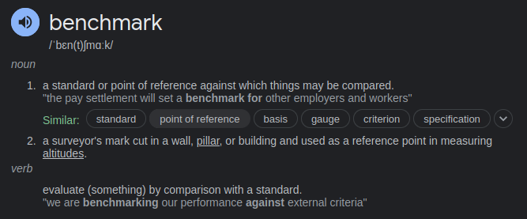
Benchmarking

Slide 60
Benchmark in Computing
An act of running a computer program, a set of programs, or other operations, in order to assess the relative performance of an object.
Assesses performance characteristics of computer hardware, ex.: floating point operation performance of a CPU.
Also applicable to software.

Slide 61
Benchmark in Computing
Method of comparing the performance of various subsystems across different chip or system architectures.
SPEC (Standard Performance Evaluation Corporation)
Establishes and maintains standardized benchmarks and performance evaluation tools for new generation of computing systems.

Slide 62
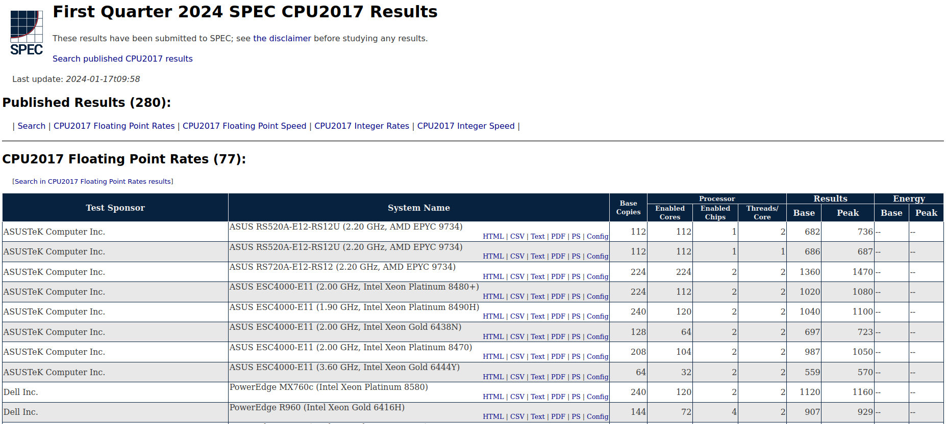
SPEC Results

Slide 63
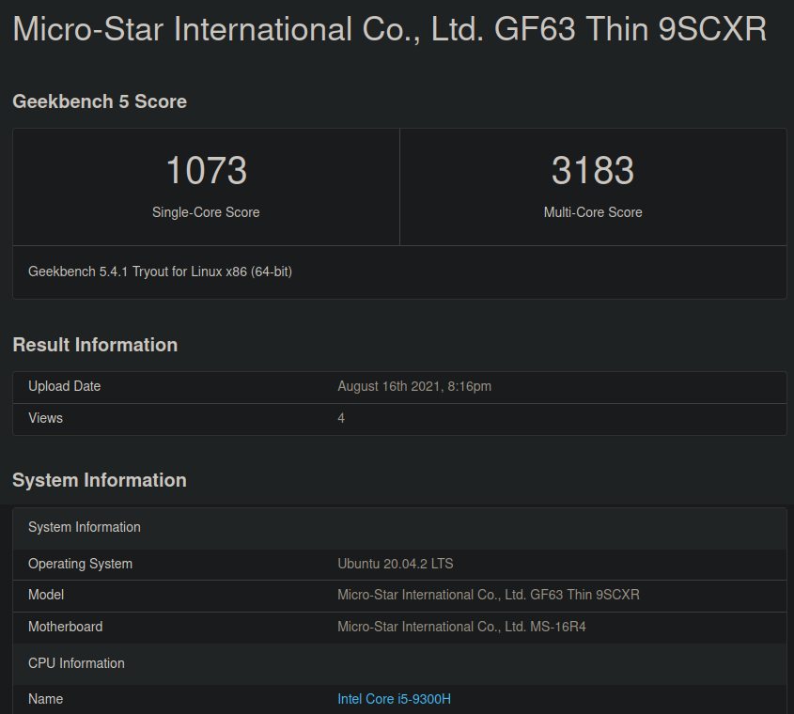
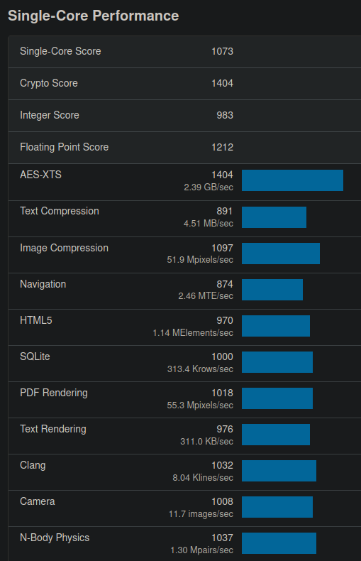

Can I benchmark my CPU?

Slide 64
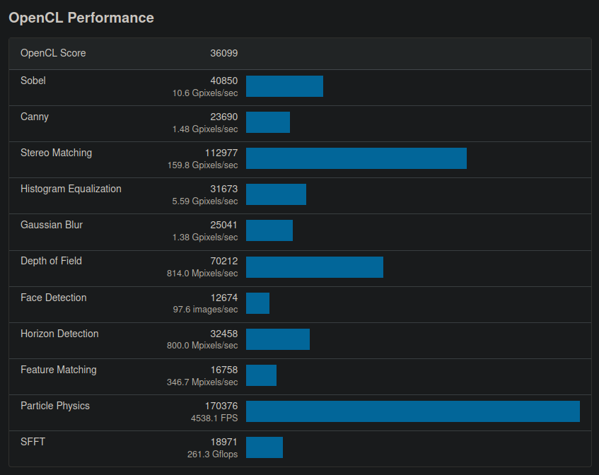
What about GPU?

Slide 65
Need to generate our own benchmarks?
Program/algorithm you are working on is different from the ones available in SPEC.
Examples:
Memory access patterns are uncommon.
Program analysis shows bottlenecks in more than one stage of CPU pipeline

Slide 66
How to generate our own benchmarks?
Computer architecture research requires cycle level understanding of CPU behavior.
But, this level of detail comes at cost of speed, as industry standard benchmark can take weeks or months to complete, even on fastest simulators.
Need for techniques to reduce the number of machine-months required to estimate impact of an architectural modification.

Slide 67
How to generate our own benchmarks?
At runtime, programs exhibit repetitive behaviors that change over time. These behavior patterns provide an opportunity to reduce simulation time.
Identify each of the repetitive behaviors and take only one sample of each behavior to perform fast and accurate sampling.
All these representative samples together represent the complete execution of the program.

Slide 68
SimPoint
Idea: to use a program’s behavior patterns to guide sample selection.
Chooses a small set of samples called Simulation Points that, when simulated and weighed appropriately, provides an accurate picture of the complete execution of the program.
Simulating only these SimPoints can save days of simulation time with very low error rates.

Slide 69
Steps in SimPoint
Interval
Phase
Similarity
Frequency Vector, here Basic Block Vector (BBV)
Similarity Metric
Phase Classification

Slide 70
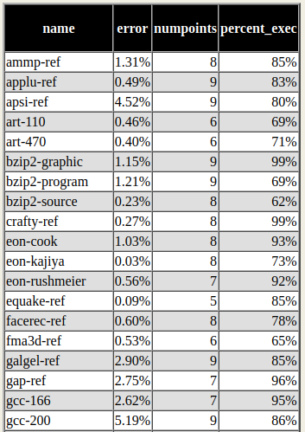
Error Rates in SimPoint

Slide 71
Trace generation
Trace: process of capturing data that illustrates how the components in a design are operating, executing and performing.

Slide 72
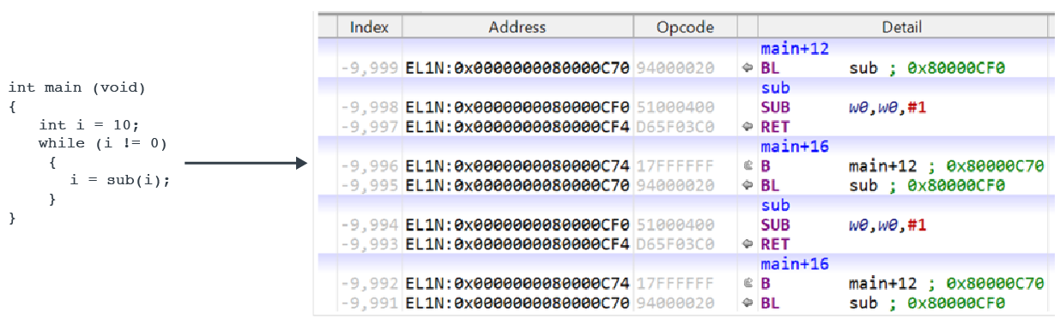
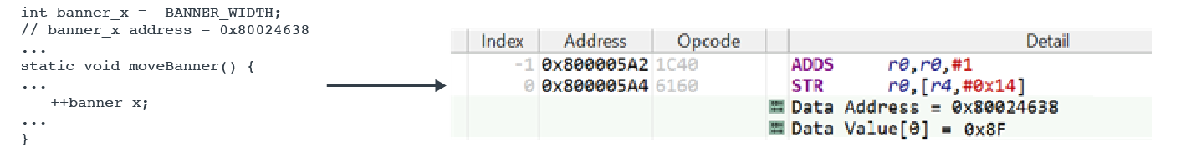
Trace generation

Slide 73

Trace generation using Intel’s Pin
Dynamic Binary Instrumentation Framework
Enables you to write modules that execute some program and insert code into it at execution time to track things you are interested in.
Can easily hook any function in the program.
Used to instrument binary and collect runtime data

Slide 74
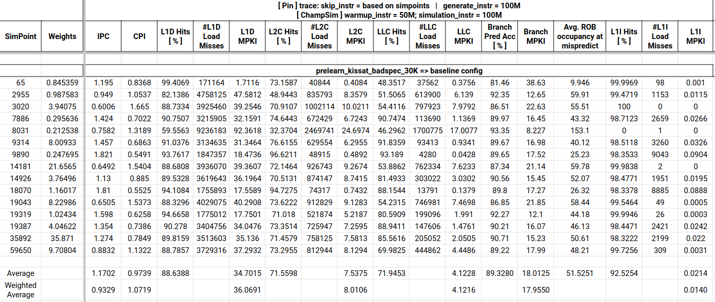
Example

Slide 75
Arigato! 😀

